Slide 1

Portfolio Python
By: Steve VOGEL

Slide 2
Introduction
• Select Stocks (2-4) @ current risk with 3 yr predicted Close
• Input Variable: Historical Close
• Target Variable: Predicted Close (3 yrs) Reflecting Investor Retirement
• Worked/Didn’t work: Will Review
•Monte Carlo chosen as accurate historical predictor
• FB Prophet chosen as a well functioning predictor

Slide 3
Cupcake, Birthday Cake and Wedding Cake
 | Analyze Portfolio | Optimization of Portfolio | Optimize Models
 | Cupcake | Birthday Cake | Wedding Cake
Models | 1. Import cryptocurrency ETH, SOL, ADA PACA, Yahoo Finance, int Python. | 3. Expand Monte Carlo model adding Sharp, additional probability analysis, improved predictive view and risk. | 6.Machine Learning sklearn, rainforest stock predictor model review for opportunities to improve learning.
 | 2. Analyze Cryptocurrency using stock metrics. | 4. Improve visualization in F Profit model to show range of forecast, adjust to sizing and color. | 7. Create ERC20 Token model with purchasing to fund, showing inheritization using Solidity, Remix
Quality |  | 5. Add seaborn to improve visualization.

Slide 4
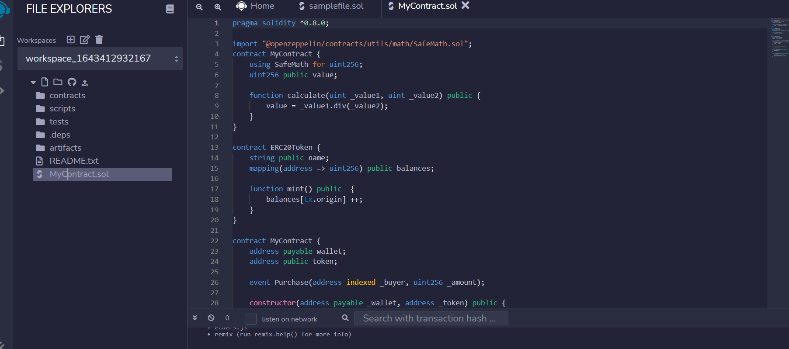
REMIX IDE: Use of Solidity, REMIX IDE for ERC20 Token Minting

Slide 5
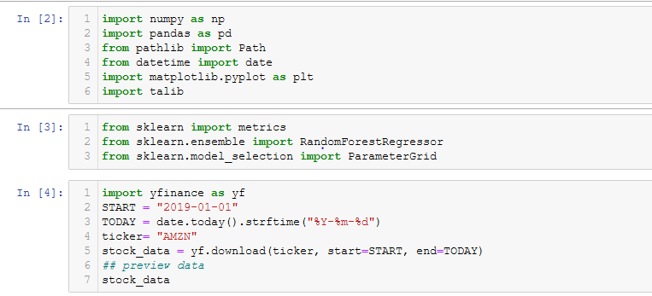
Machine Learning Slide 1

Slide 6
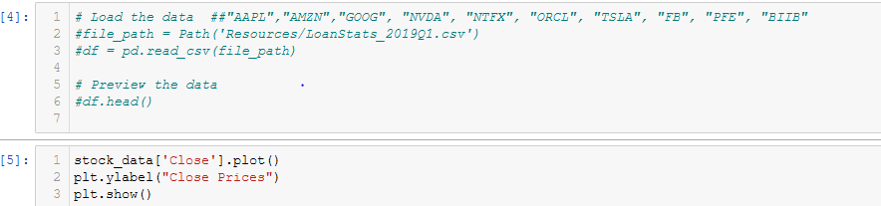
Machine Learning Slide 2

Slide 7
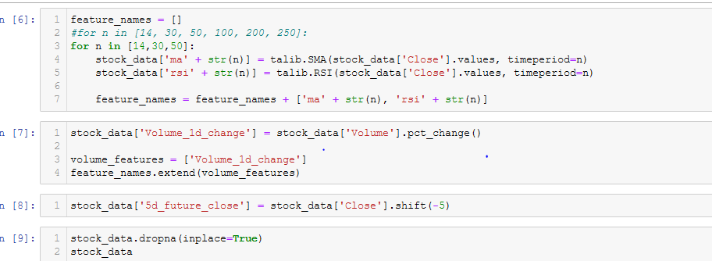
Machine Learning Slide 3

Slide 8
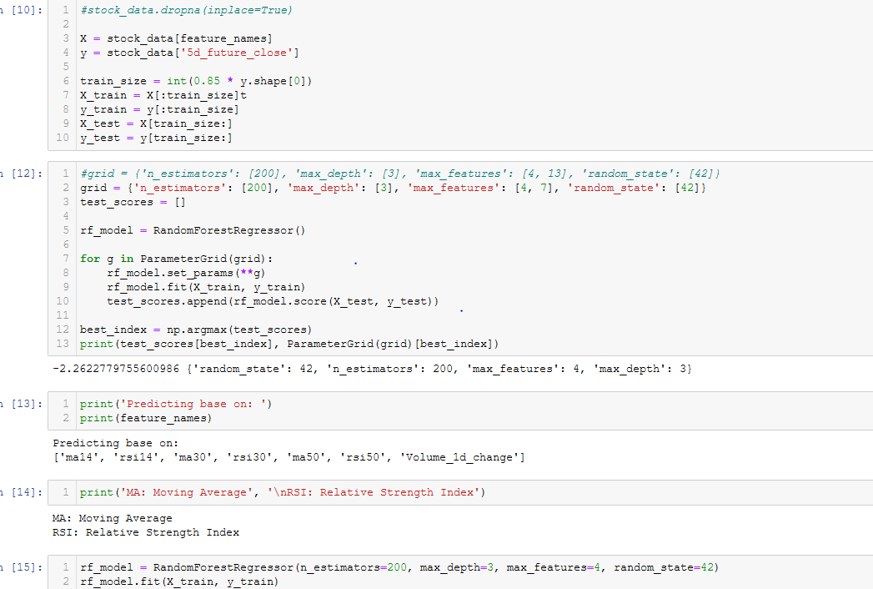
Machine Learning Slide 4

Slide 9
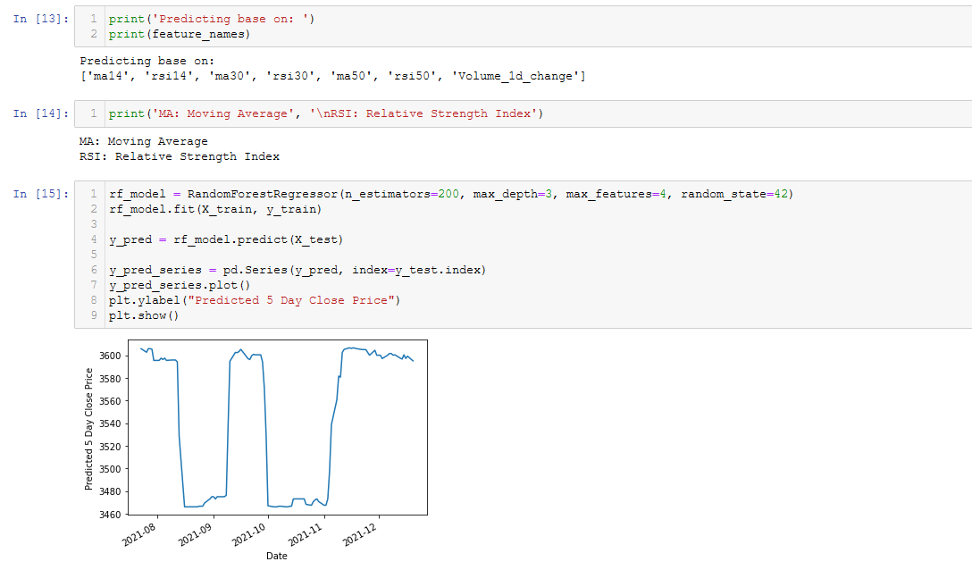
Machine Learning Slide 5

Slide 10
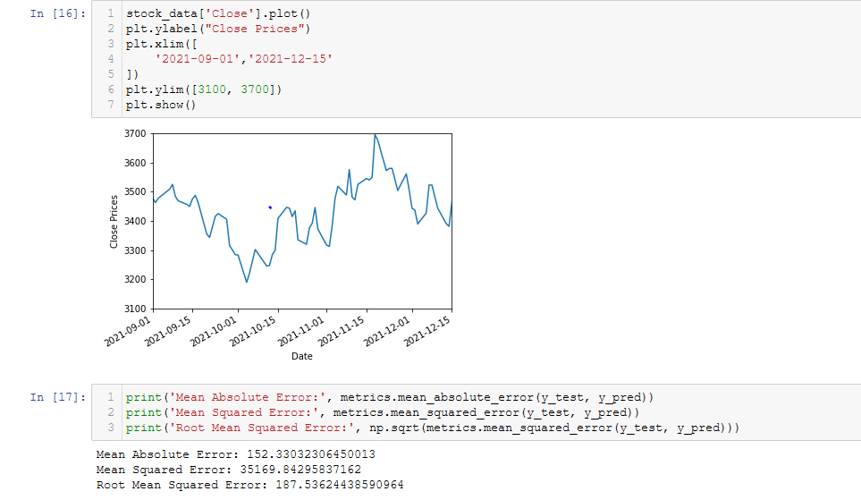
Machine Learning Slide 6

Slide 11
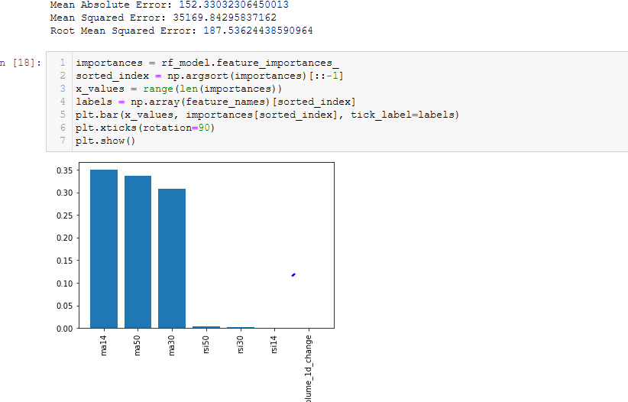
Machine Learning Slide 8

Slide 12
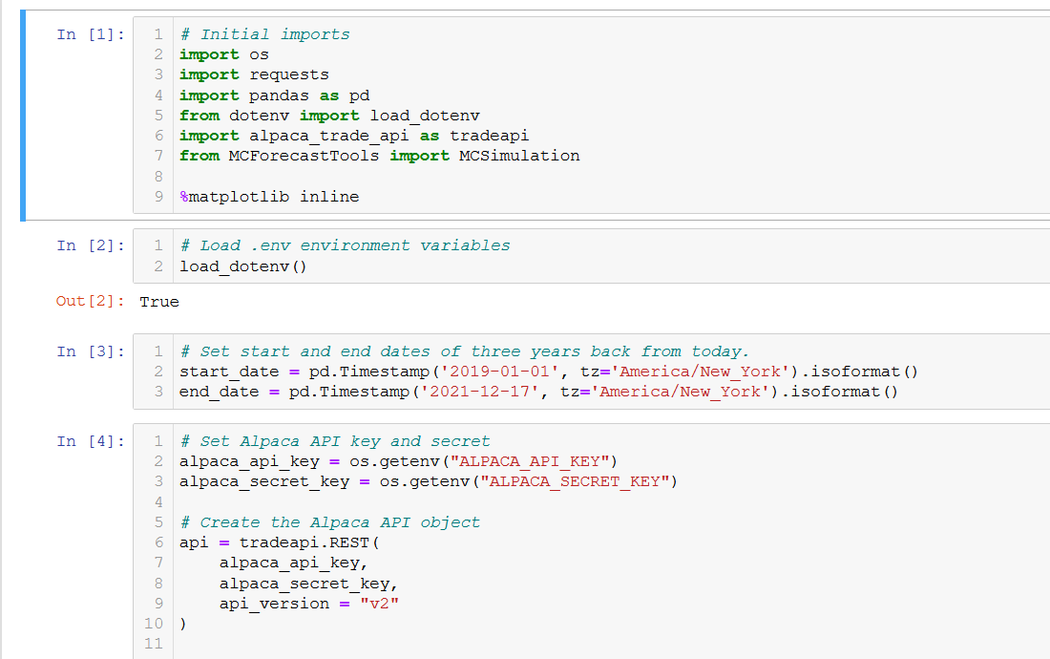
ALPACA MONTE CARLO Slide 1

Slide 13
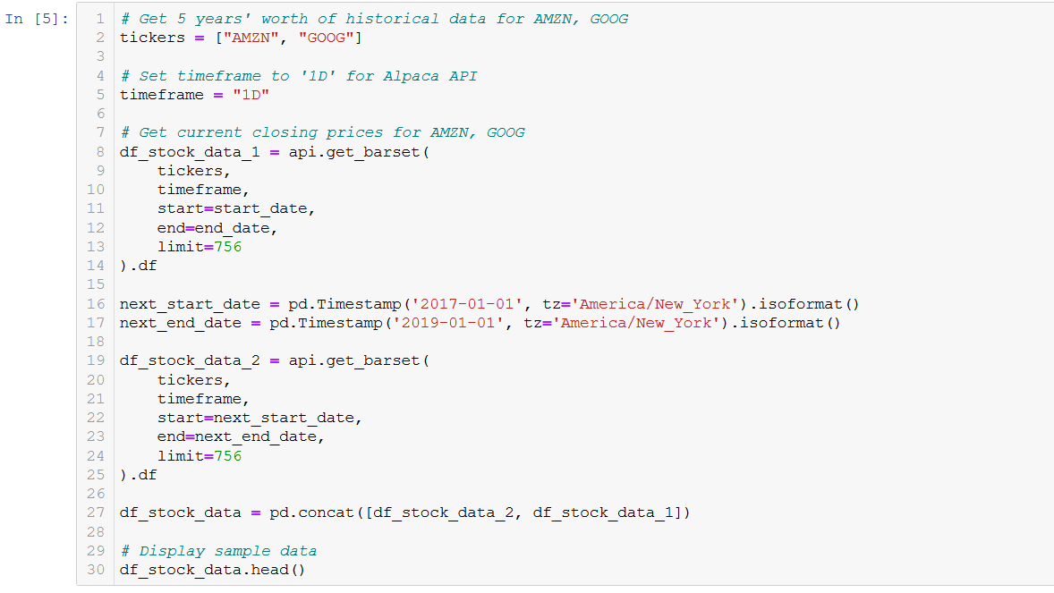
ALPACA MONTE CARLO SLIDE 2

Slide 14
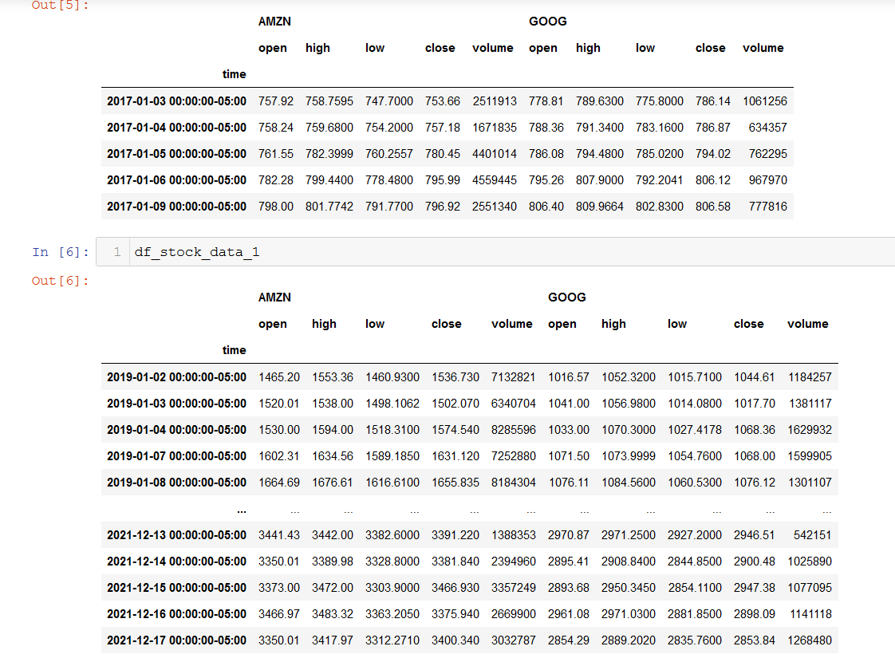
DF ALPACA MC Slide 3

Slide 15
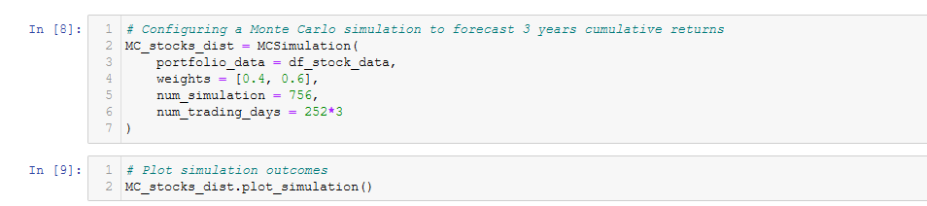
ALPACA MC Slide 4

Slide 16
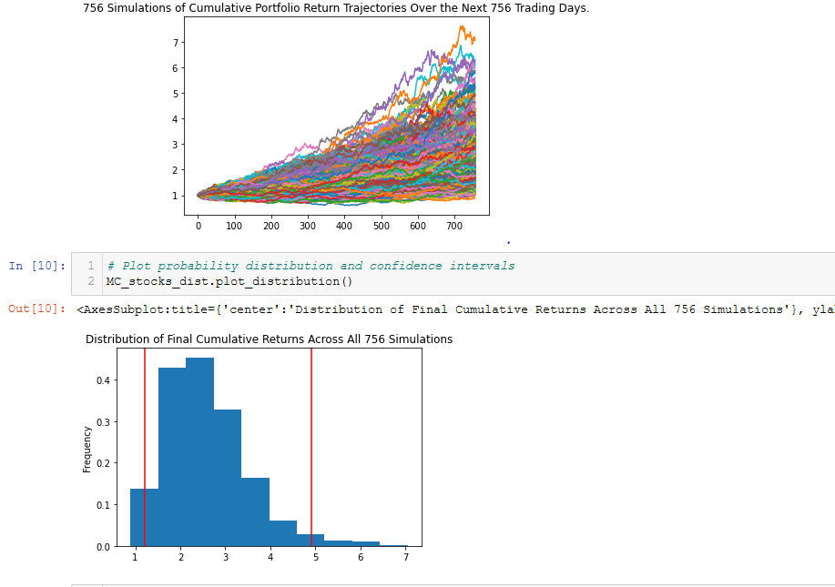
ALPACA MONTE CARLO SLIDE 5

Slide 17
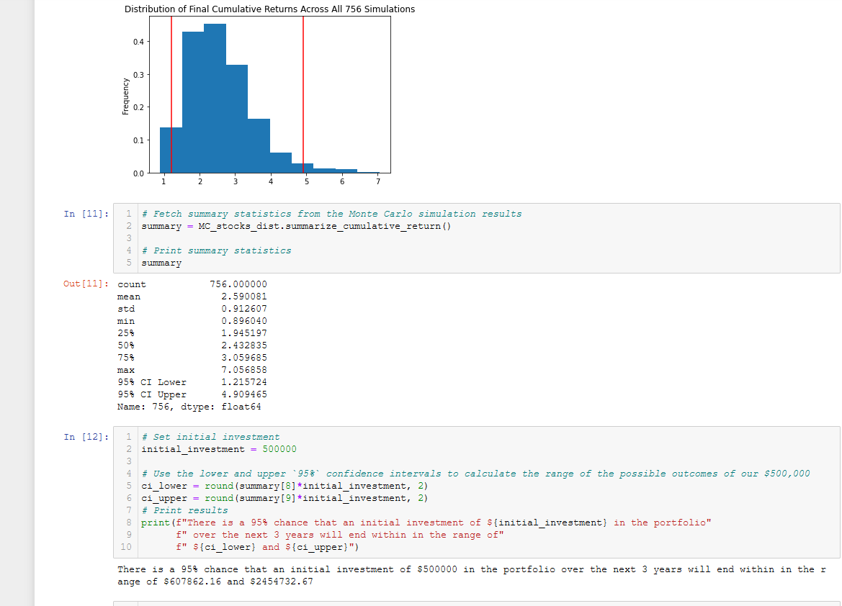
ALPACA MONTE CARLO Slide 6

Slide 18
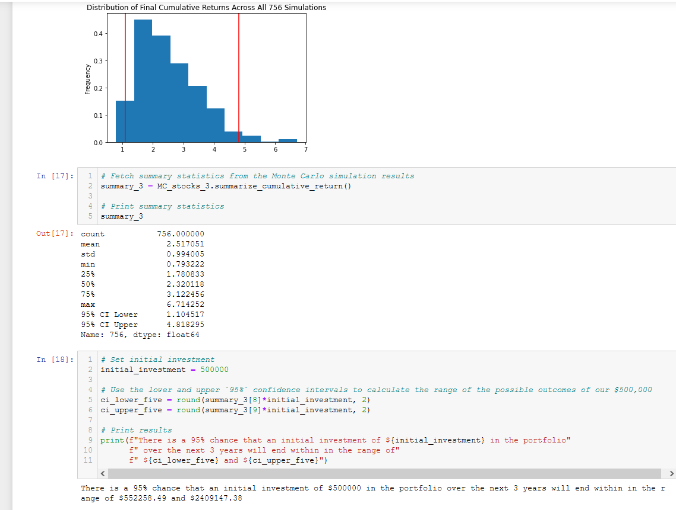
ALPACA MONTE CARLO Slide 7

Slide 19
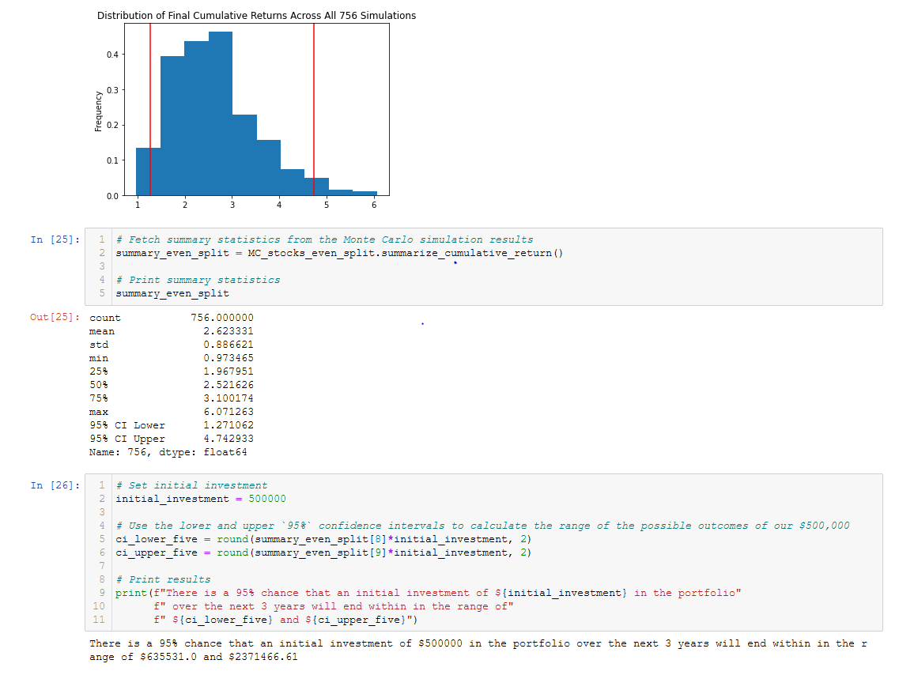
ALPACA MONTE CARLO Slide 8

Slide 20
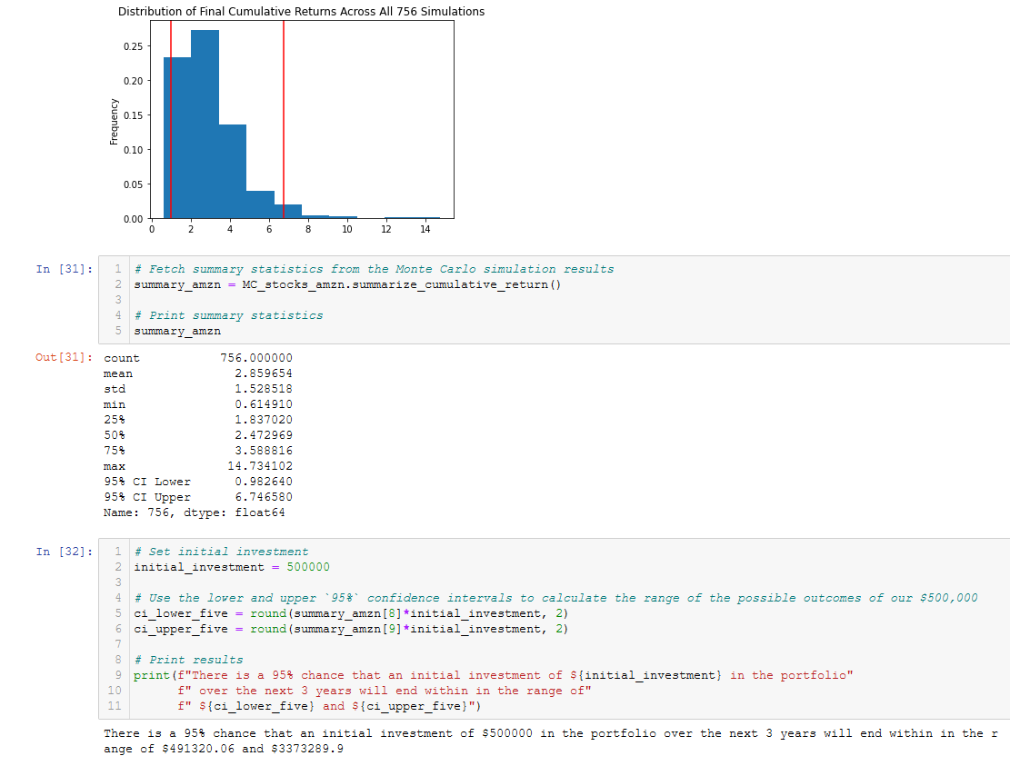
ALPACA MONTE CARLO Slide 9

Slide 21
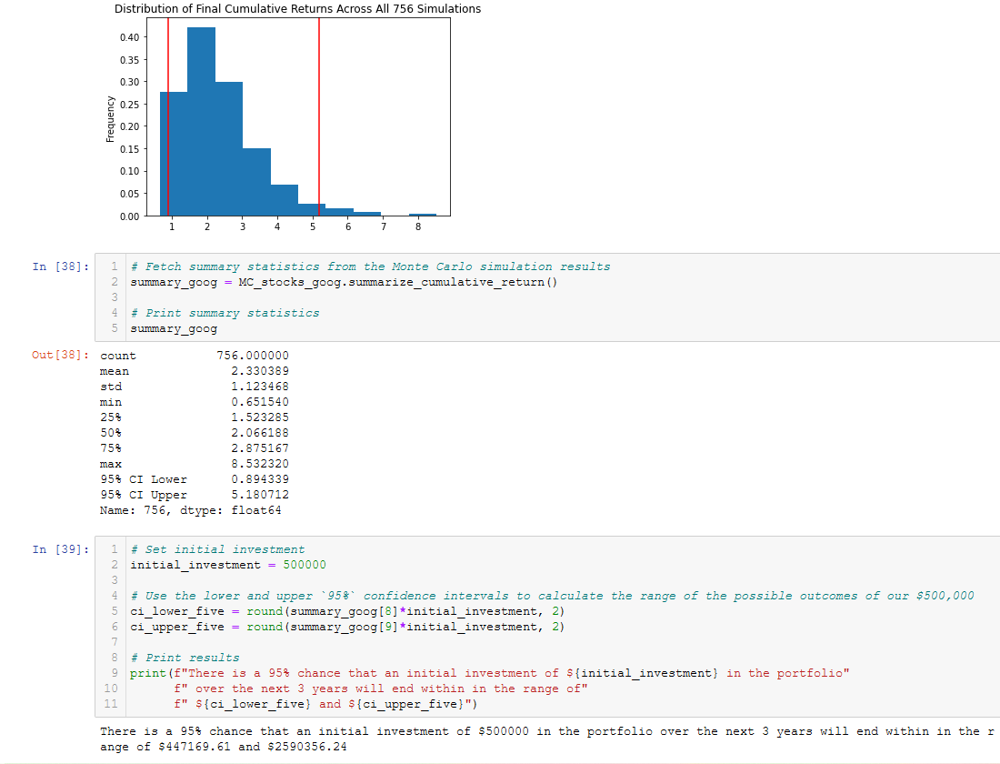
ALPACA MONTE CARLO Slide 10

Slide 22
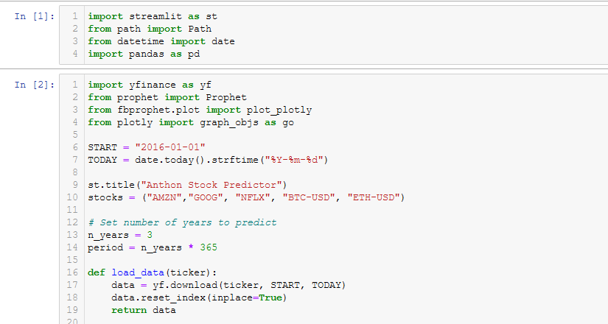
FB Prophet Forecast Slide 1

Slide 23
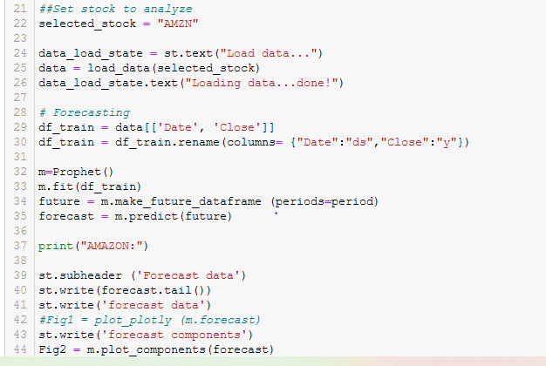
FB Prophet Forecast Slide 2

Slide 24
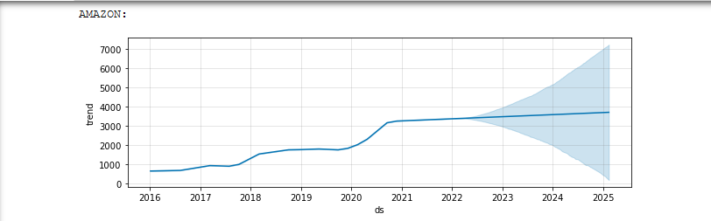
FB Prophet SLIDE 3

Slide 25
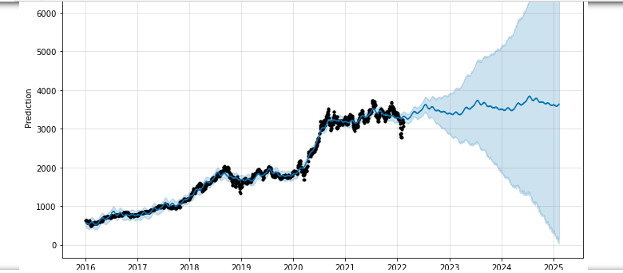
FB Prophet (Daily not smoothed) SLIDE 4

Slide 26
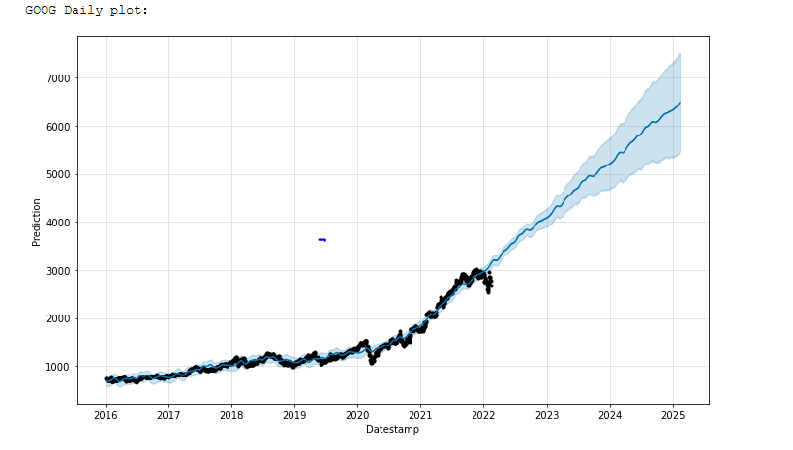
FB Prophet Slide 5

Slide 27
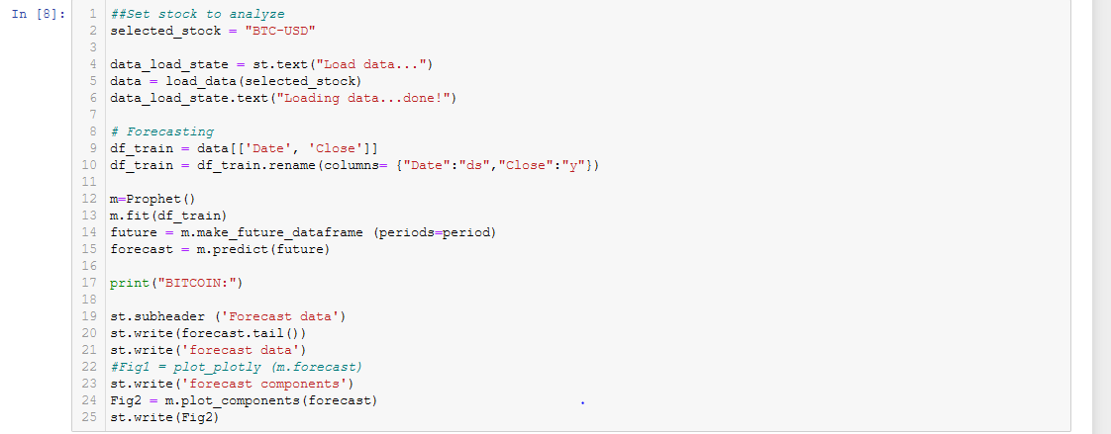
BITCOIN Review Slide 6

Slide 28
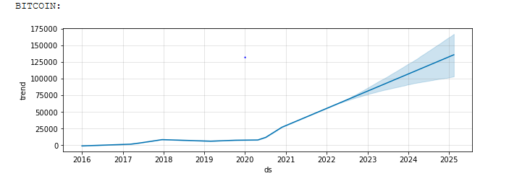
BITCOIN Review Slide 7

Slide 29
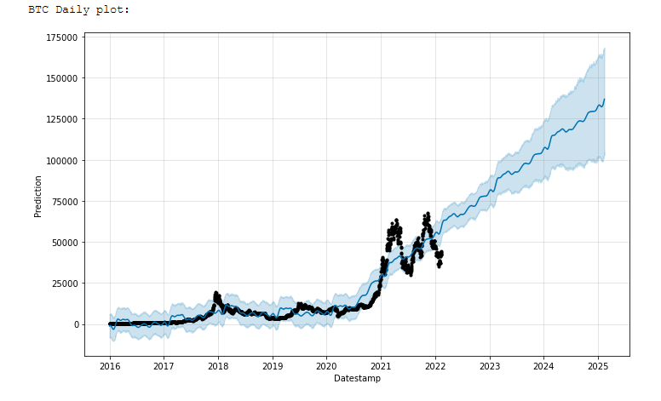
BITCOIN Slide 8

Slide 30
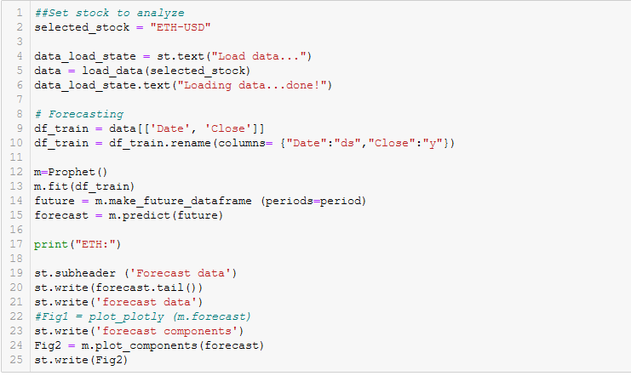
ETHEREUM Slide 9

Slide 31
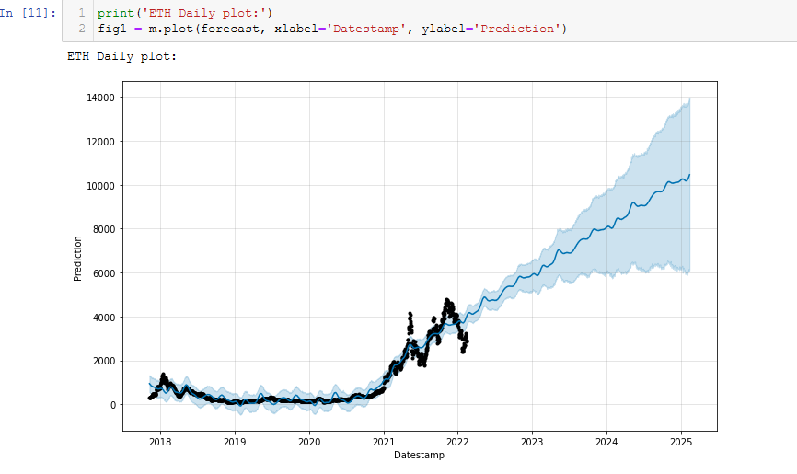
ETHEREUM Slide 10

Slide 32
Conclusion & Recommendations
1. The current portfolio has performed well. ADP is a sound and growing Corporation. Its spin-offs helped diversify Anthon’s holdings.
2. Anthon’s current IRA, managed by Morgan Stanley has seen healthy returns.
3. The Anthon Portfolio can be replaced by a higher yielding Proposed Portfolio AMZN, GOOG,
4. May benefit by Cryptocurrencies BTC, ETH. This provides strong results, unclear if Crypto currency is acceptable.

Slide 33
Portfolio Python (P3 )– Client’s Portrait – Interview for Portfolio analysis - 2
Current Portfolio Composition | Proposed Portfolio Composition – Birthday Cake | Crypto Thoughts for future – Wedding Cake | Benchmarks
ADP : 1000 shares (from former employer from 24 yrs.) | AMZN, GOOG | BTC or ETH or SOL or DODG | SPY, NASD, DJIA
BR: 500 Shares
CDK: 950 shares
IRA value: 500K

Slide 34
Portfolio Python (P3 )– Client’s Portrait – Interview for Portfolio analysis – Background Data
Demographics | Finance : current | Comments : Future
64 Years old | Annual Income: 100 K | Projected Social Security Monthly 2.8K
Married, 3 dependents | Home Value: 400K | Homes appreciating 2% annually
BS in Finance (has not yet studied Python nor pandas) | Mortgage owed: 200K Monthly payment $1,900 | 4-5 years into a 15 year mortgage @ 2.75%
Excellent Health | Annual Spending: 100K | Plays in league bowling and softball
Morgan Stanley Advisor(MS) | Savings: Stock, IRA, Pension | Largest asset IRA now managed by MS
Proposed retirement date : 11/1/2024 | Monthly Mortgage: 1.9K | Retirement Net Worth Required : 1, 500K

